Slide 1
EQUALS Her Digital Skills Initiative

Slide 2
EQUALS Global Partnership

Slide 3
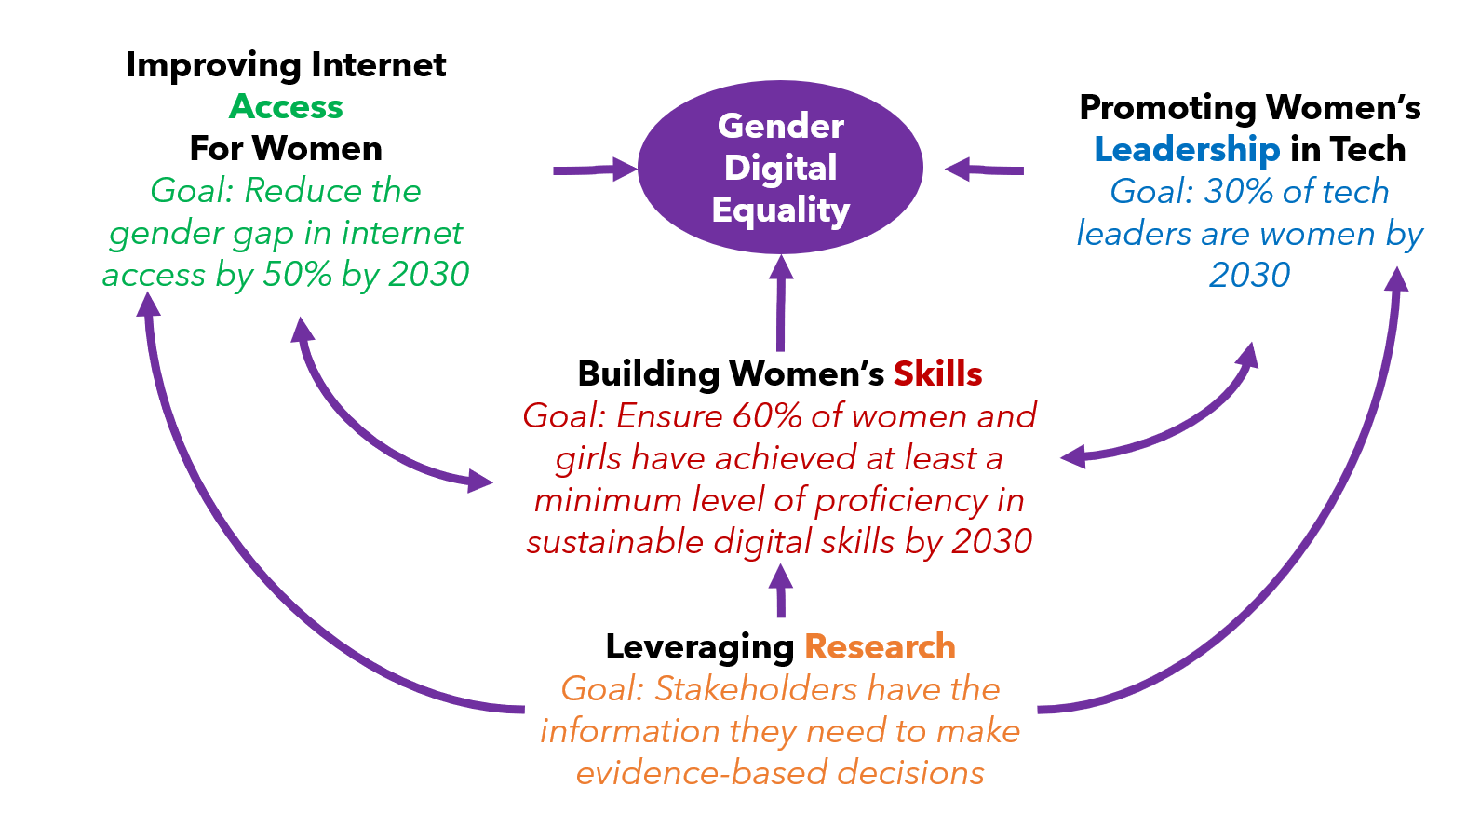
How Does it Aim to Bridge the Digital Gender Gap?

Slide 4
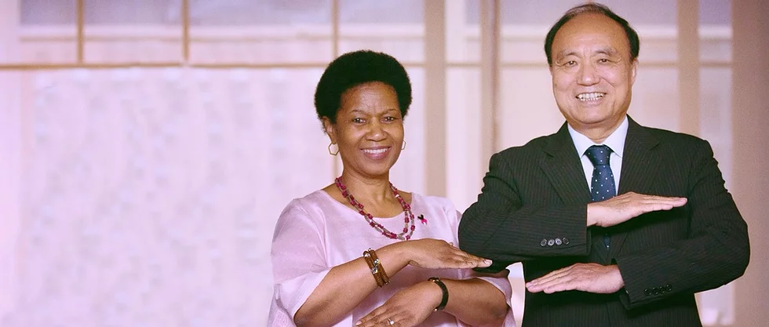
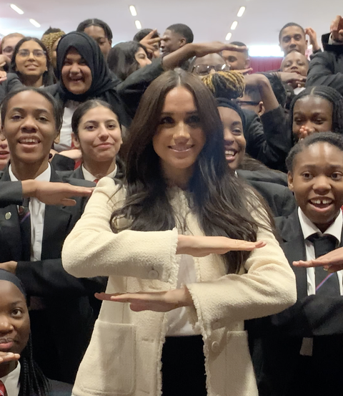
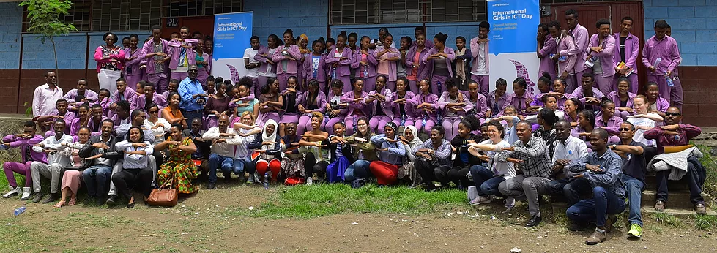
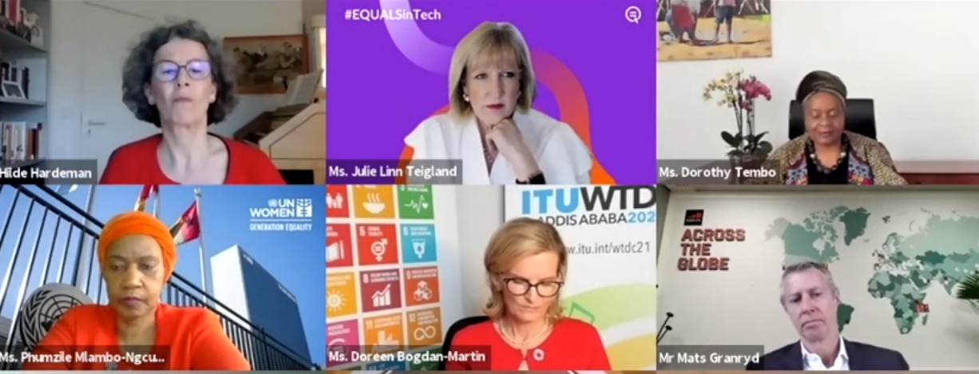
MATS GRANRYD SPEAKING AT AN EQUALS PANEL AT
BEYOND MANY OTHER SUCCESSFUL SOCIAL MEDIA CAMPAIGNS AND MOVEMENTS THE EQUALS HAND SIGN
BECAME VIRAL AND APPEARED IN NUMEROUS SOCIAL MEDIA POSTS OF GENDER EQUALITY PIONEERS, AS WELL AS NOTABLE PUBLIC AND PRIVATE SECTOR LEADERS.
SUCCESFUL PUBLICATION OF GSMA LED STUDY ON
PERCEPTIONS OF POWER – CHAMPIONING FEMALE LEADERSHIP IN TECH

Slide 5
OVER 100 PARTNERS INCLUDING:

Slide 6
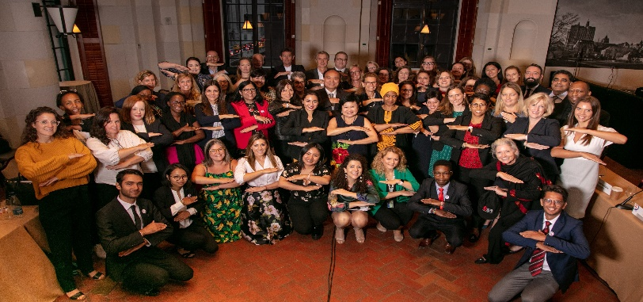
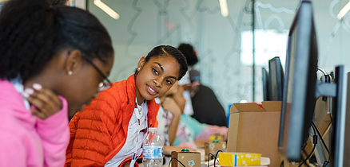
GSMA is One of the Five EQUALS Co-Founders
EQUALS Hub
Skills
Leadership
Chair of EQUALS Steering Committee
Strategic Advice & Development of EQUALS Governance and Ethics Charter
Project Lead for EQUALS Tech4Girls Workshops & E-mentoring
Project Partner for EQUALS Badges (Digital Skills Training & Certification Platform)
Co-Publisher of Perceptions of Power: Championing Female Leadership in Tech Publication
Project Partner to EQUALS EU Capacity Building Project

Slide 7
Access ICT
Onboard & be inspired
Develop & advance digital skills
Build expertise & get employed
HER DIGITAL SKILLS
Basic introduction to the technical knowledge and education needed for careers in technology through hands on workshops, designed to inspire underserved girls and young women (10-25 years)
Access to free, gender transformative IT skills training & an EQUALS qualification (“the Digital Badge” – foundational, advanced & expert skills) boosting women’s chances of pursuing further training/studies and access to formal employment in the ICT sector
Connecting established companies from among the tech and mobile industries to young women to increase interest, involvement, and awareness of the overall role of industry in bridging the gender gap in leadership
TECH4GIRLS Workshops
EQUALS Badges
TECH4GIRLS E-Mentoring
Design and provide access to free gender transformative foundational IT skills training and e-mentoring for 1 million women and girls by 2026

Slide 8
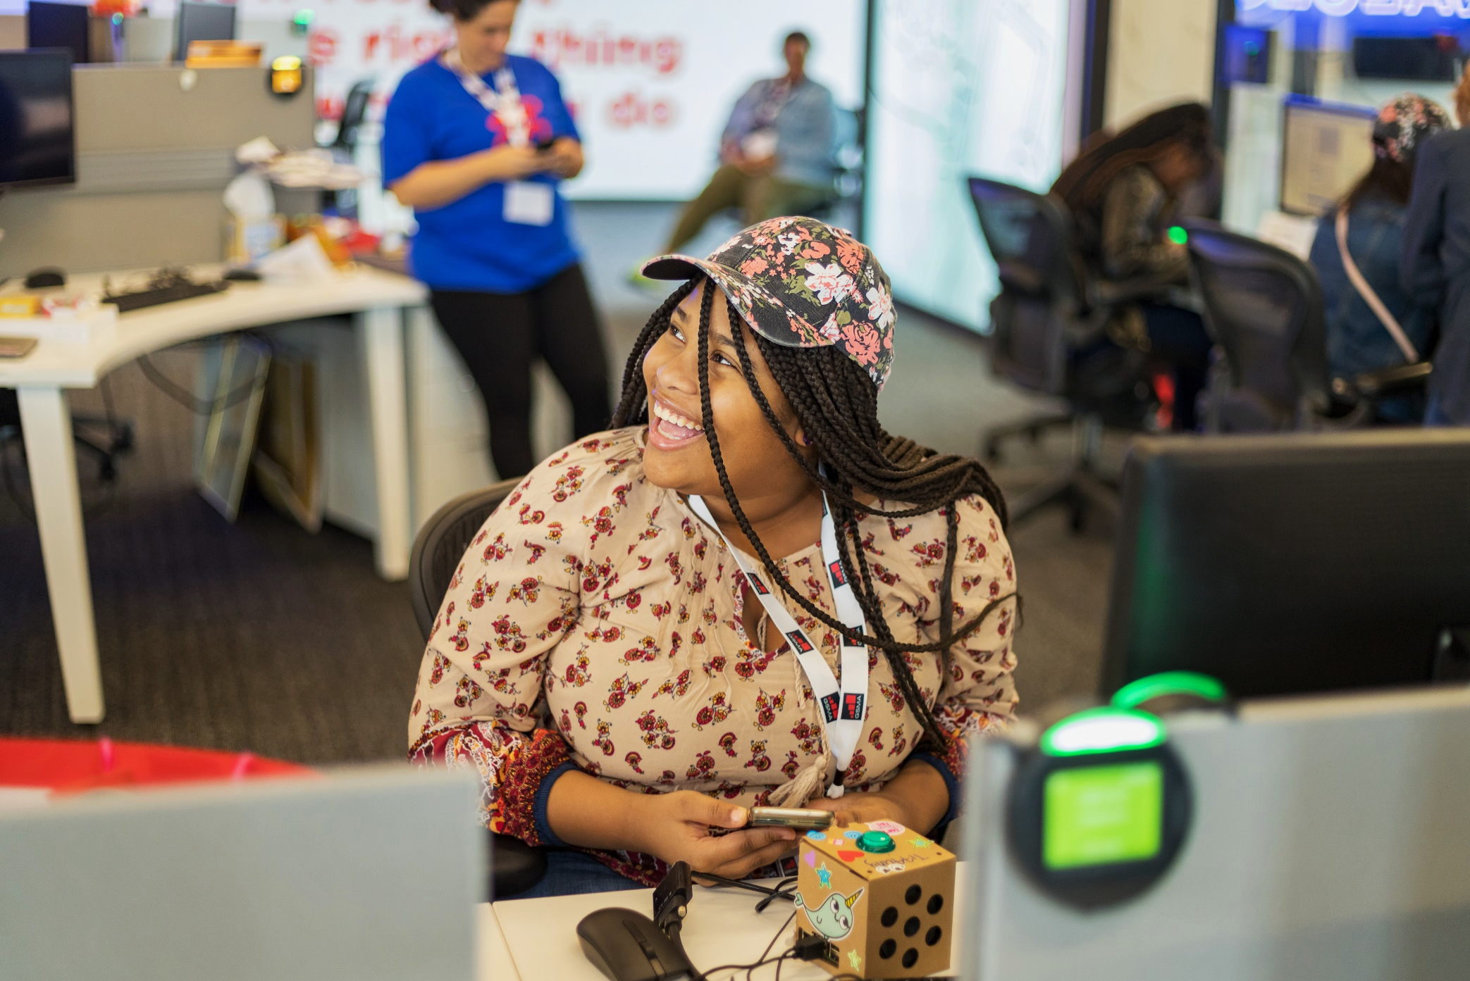
EQUALS Her Digital Skills Initiative
Sponsor
Founders
Members

Slide 9
What is EQUALS Tech4Girls?
Delivering Sustainable Development Goals Quality Education and Gender Equality
Education | Exposure and Mentorship | Talent Pipeline
Provide young girls with the technical knowledge, education, and skills to prepare them for careers in technology through instruction. | Connect established companies and girls to increase interest, involvement, and awareness of the overall tech industry and to foster mentorship opportunities. | Increase talent pipeline of girls in STEM/STEAM.

Slide 10
TARGET GROUP
WORKSHOP TYPE
OBJECTIVES
Mobile App Development
Basics of creating apps for smartphones
Development and design of own and unique self-made products / apps using THUNKABLE
Gain self-confidence that STEM is a viable career option
Better understand what it takes to enter a career in STEM
Gain valuable insights into key tech concepts
Upskill in STEM subjects
Girls 10-16 years
Introduction to Tech through E-Commerce
Creating an online store using Shopify
Basic concepts relating to Digital Marketing and Ads Placement
Young Women 16-25 years

Slide 11
Tech4Girls Roadmap 2020-2021
Taiwan
India
Philippines
Trinidad
Kenya
Kenya
OCT NOV DEC JAN FEB MAR APR MAY JUN JUL AUG SEP OCT NOV
Jamaica
Commonwealth
Commonwealth
Jamaica
Uganda
Burundi
Australia
Pakistan
Trinidad

Slide 12
Changing the
perception of
technology.
70%
increased participant knowledge of STEAM career opportunities
94%
88%
improved participant understanding of STEAM, and possible career paths within STEAM
felt confident about pursuing further tech studies/a career in tech

Slide 13
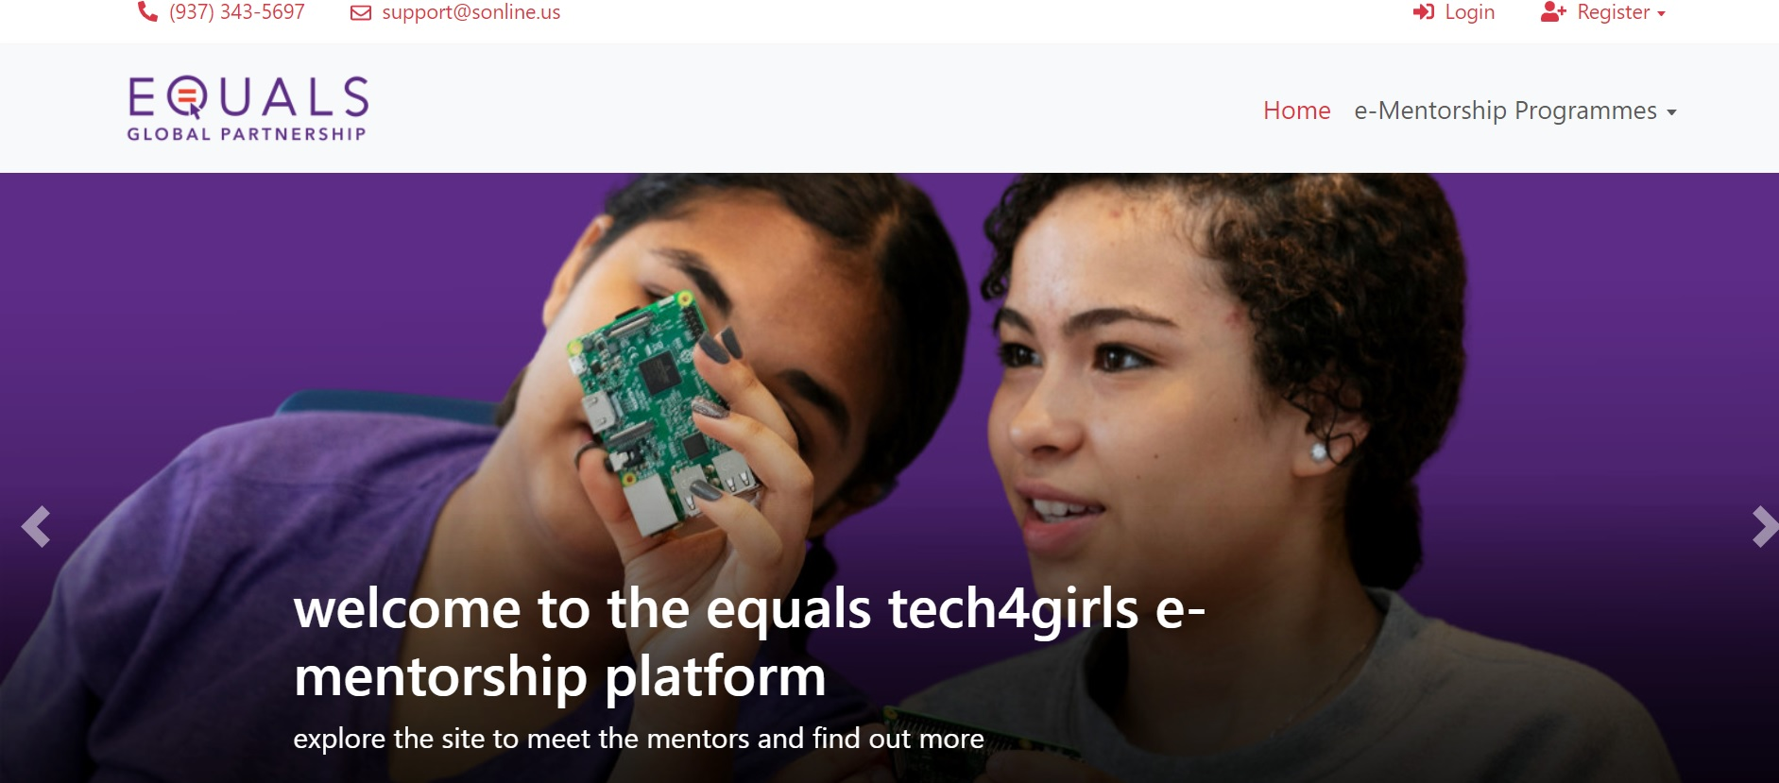
EQUALS Tech4Girls E-Mentoring Programme

Slide 14
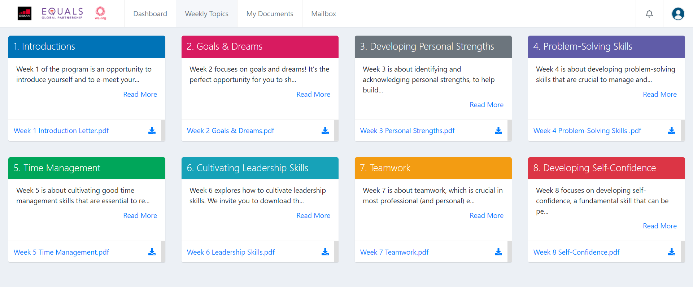
8 Weeks Soft-Skills Training Programme

Slide 15
EQUALS Badges Programme

Slide 16
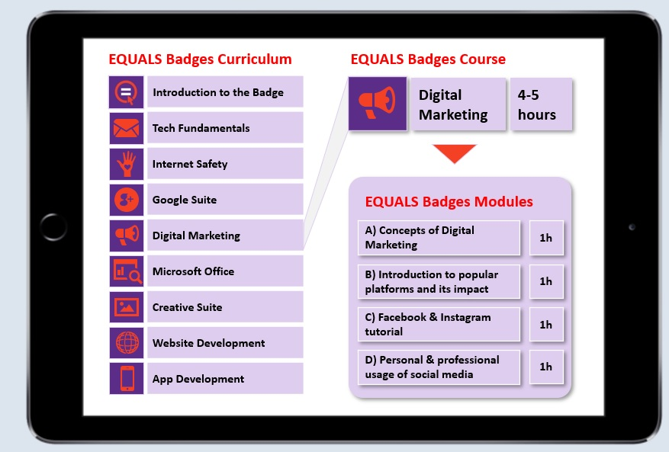
EQUALS Badges Programme
While the Tech4Girls project aims to inspire and upskill girls on the ground in 1-day workshops, the EQUALS Badges can be pursued afterwards to strengthen their skill set

Slide 17
Long Term Impact: EQUALS Badges Programme

Slide 18
EQUALS Badges Programme
# | Courses | Foundational | Advanced | Expert
0 | Introduction to the EQUALS Badge | Explaining the purpose of the program | Explaining the purpose of the program | Explaining the purpose of the program
1 | Tech Fundamentals | Basic parts of computer & inside a computer Operating system Internet, skype, zoom & Microsoft | Computational Thinking, Programming Techniques | Networking fundamentals
2 | Internet Safety | Intro to Internet safety How to navigate safely through the internet Safe online shopping & social media privacy | To be further defined | To be further defined
3 | Google Suite | Using Gmail as basic communication tool Opportunities of Google Play Store, Drive, Map, Duo, Forms | Google Doc, Google Sheet | Google slides, YouTube
4 | Digital Marketing | Concepts of Digital Marketing Introduction to popular platforms (FB, IG, LI) Personal & professional usage | Facebook for business | LinkedIn Learning Optimizing Profile
5 | Microsoft Office | Introduction to Word & how to use it Learning basic tools (i.e. text formatting, find & replace, table etc.) | MS Excel | MS Power Point , Outlook
6 | Creative Suite | Introduction to CANVA Creating Facebook posts, twitter quote posts, YouTube banners & flyers | MS Publisher | Adobe Photoshop
7 | Website Development | Introduction to HTML & how to create a webpage with it HTML elements: Tags, List, Interactive elements Block-level, Inline & Organizational Elements Meta-data & the Head Element | CSS | Java Script
8 | App Development | Introduction to Thunkable Components of Thunkable User Interface Decision Making, Voice Recognition Publishing App on Play Store | Object Oriented Programming | Intro. to Java programming

Slide 19
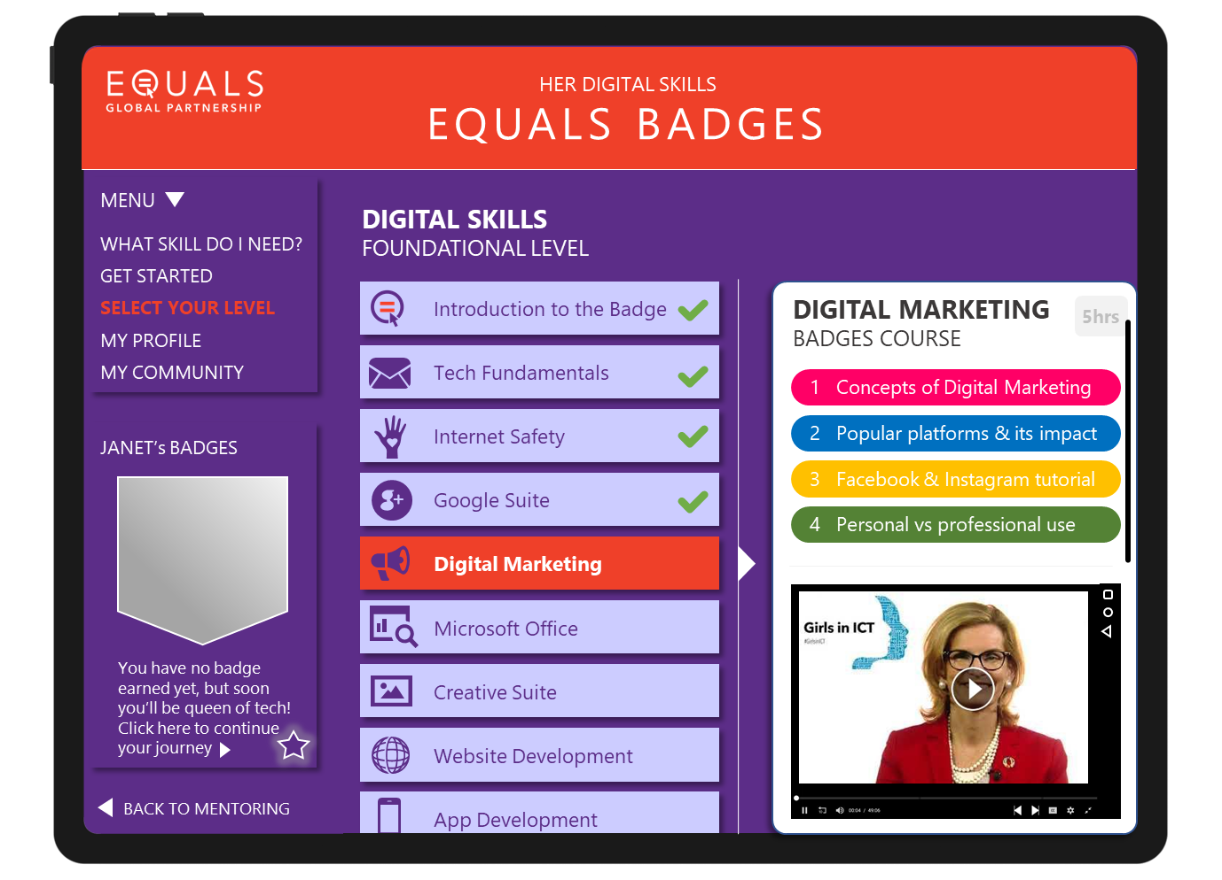
HER DIGITAL SKILLS
2021 Impact
Next steps
Increasing impact & scale by combining 3 EQUALS projects into one holistic initiative and platform: HER DIGITAL SKILLS
1st six months: 1418 participants across 15 countries and 4 continents (Tech4Girls workshops & e-mentoring)
Collaboration with ITU Academy to host EQUALS Badges platform
Alignment with the Generation Equality Innovation and Technology Action Coalition
Scale up in # of participants and countries for workshops & e-mentoring
Develop UX Design and content for foundational digital skills badge
Mobilize sufficient project funding
Founding Partners
with kind support of

Slide 20
Thank You
www.equalsintech.org; equals@itu.int

